Slide 1
Deploy and Run a Distributed Cloud Native system using Istio, Kubernetes & .NET core ProgNet 2019
Sep 2019
Sreenivas Manyam Rajaram
Notes:
Hi Everyone, this is Sreeni

Slide 2
Know
Pivotal AppTx
Help Customers with Journey to PCF / PKS
.Net 4x / Core
sreenivas_mr@yahoo.com
Me

Slide 3
Know
Docker
Kubernetes
Istio
You

Slide 4
Agenda
Developer workflow
Kubernetes Landscape
PKS Overview
Kubernetes Overview
Istio Basics
Meet the Fictitious App
Build and Run the App in PKS / Istio
Workshop

Slide 5
Developer Workflow
Notes:
Lets demystify the magic. If you had to do it all yourself manually, you would have
Created a new dotnet core proj
Used VS code to edit code if required
Created a docker image for your application
Tagged the docker image
Pushed the docker image to a docker registry
Created required resources on Kubernetes using yaml and kubectl
Viewed the app in browser
Kubernetes orchestrates the container images

Slide 6
Kubernetes
Landscape
Notes:
PKS runs on both public and private cloud. Ops exp with each public cloud is different, but with PKS you get consistent ops experience everywhere.

Slide 7
PKS
OpsMan
VSphere Client
NSXT
Harbor
Overview
Notes:
Show all the dashboards.

Slide 8
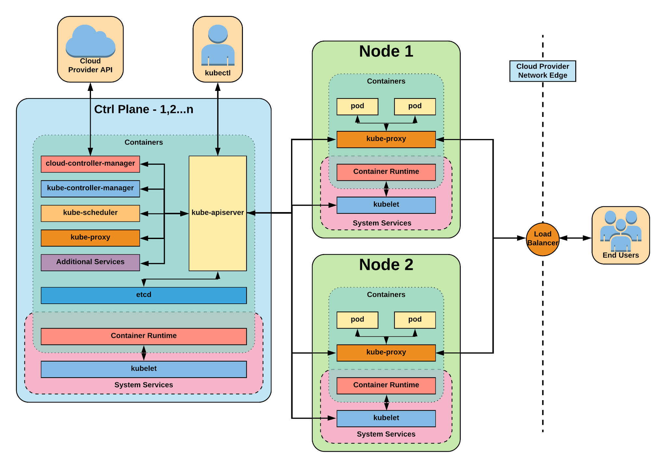
Kubernetes
Architecture Overview
Notes:
Kubernetes is divided into Control Plane and Data Plane.
Control consists of the components which manage the Data Plane. Data plane hosts the applications deployed by application developers.
There can be more than one set control plane objects in Kubernetes, which makes it Highly Available.
Kube-apiserver
Gate keeper for everything in kubernetes
EVERYTHING interacts with kubernetes through the apiserver
Etcd
Highly available Distributed key value based storage back end to store cluster state, objects and config
The apiserver is the only thing that talks to it
Kube-controller-manager
Its the director behind the scenes
The thing that says “hey I need a few more pods spun up”
Does NOT handle scheduling, just decides what the desired state of the cluster should look like
e.g. receives request for a deployment, produces replicaset, then produces pods
kube-scheduler
scheduler decides which nodes should run which pods
updates pod with a node assignment, nodes poll checking which pods have their matching assignment
takes into account variety of reqs, affinity, anti-affinity, hw resources etc
possible to actually run more than one scheduler
Kubelet
Agent running on every node, including the control plane
On workers: poll kube-apiserver looking for what they should run
On masters: run the master services as static manifests found locally on the host
Kube-proxy
The network ‘plumber’ for Kubernetes services
Enables in-cluster load-balancing and service discovery
Container Runtime Engine
The containerizer itself - typically docker
Additional Services
CoreDNS
Kube Dashboard
Networking
Pod Network
Every pod gets its own cluster wide unique IP, and makes use of the CNI plugin
Service Network
Cluster-wide range of Virtual IPs managed by kube-proxy for service discovery.
Container Network
Containers within a Pod share the same IP and communicate over localhost

Slide 9
Kubernetes
Namespace
Logical grouping or partitioning of resources
Pod
Smallest unit of work of kubernetes
Services
Unified way of accessing exposed Pods
Eg: <svc name>.<namespace>.svc.cluster.local
Labels
Key-value pairs
Selectors
Use labels to filter or select objects
Core Objects
Notes:
Namespaces:
It is similar to namespaces in programming. But this is more for application architecture. You may even use it to logically separate your subdomains of application.
demo: show the below items
kubectl get namespaces
Pod
We will do a deeper dive of pods in the next slide however if you want to see all the pods in your namespace, you would do
Demo:
Kubectl get pods –n microservices
Services
Durable resource unlike pods
Static cluster-unique IP
Static namespaced DNS name
Demo:
Kubectl get services – n microservices
Service Types
ClusterIP (default)
It is strictly internal only Virtual IP
NodePort
Similar to ClusterIP but has an additional port exposed
LoadBalancer
Exposes external IP
ExternalName
Creates an internal DNS entry which can be used to reach the service from outside
Labels
Used to identify, describe and group together related sets of objects or resources
Eg: you may apply a label to your pods.
Demo: show all pods, then backend pods, frontend pods
kubectl get pods -n microservices
kubectl describe pod calcmvc-6dc47b49f-6dntr -n microservices
Selectors
Selectors use labels to filter or select objects, and are used throughout Kubernetes
Demo:
kubectl get pods -n microservices -l tier=frontend
kubectl get pods -n microservices -l tier=backend
Show CalculatorSvc-istio.yaml to make them understand how Deployment pods are bound to Services using labels and selectors

Slide 10
Kubernetes
Node X
Pod
Pod
Container
Container
App Container
Sidecar
Web server writes to log files
Sends log files to buckets
Pod Internals
Sidecar pattern
Network Namespace 10.255.16.1
External Volume
Pod Network

Slide 11
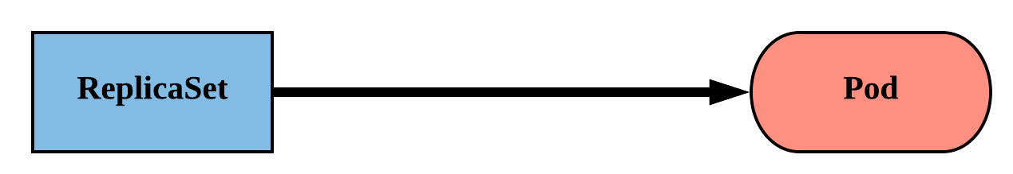
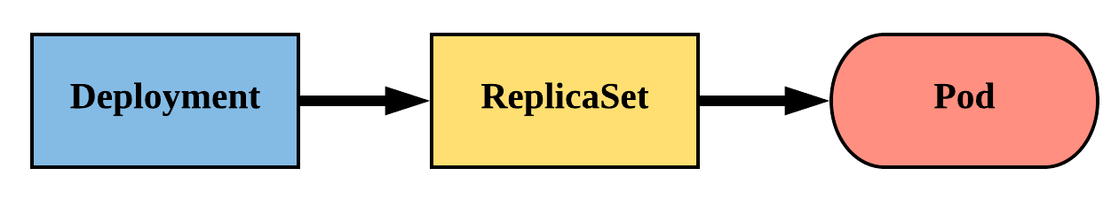
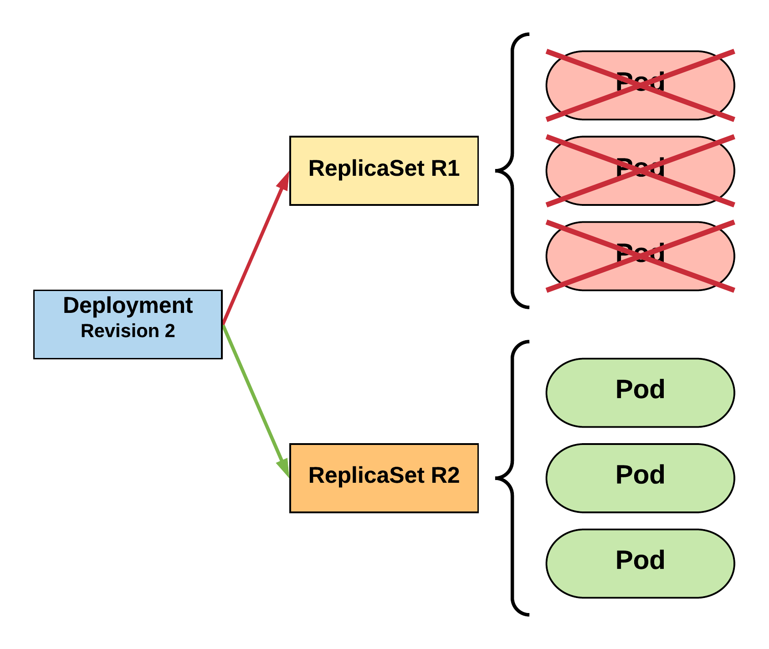
Kubernetes
ReplicaSet
Always ensure the desired number of pods are running
Deployment
Declarative method of managing Pods via ReplicaSets
StatefulSet
Tailored to managing Pods that must persist or maintain state.
Job
Job controller ensures one or more pods are executed and successfully terminated
CronJob
An extension of the Job Controller, it provides a method of executing jobs on a cron-like schedule
Workloads
Notes:
Workloads within Kubernetes are higher level objects that manage Pods or other higher level objects.
But everything revolves around (at a minimum) a Pod Template.
ReplicaSet
Their job is simple: Always ensure the desired number of pods are running.
Includes their scheduling, scaling, and deletion
Demo:
Show the replicas in the CaclulatorSvc-Istio.yaml
Deployment
Offer update control and rollback functionality, gives blue/green deployment
Rolling updates
Demo:
a new pod deployment by adding an additional label to CalculatorSvc-Istio.yaml
Kubernetes is designed with extensibility in mind. In additiont to the Core Objects and Workloads, platform developers may create Custom Resource Defenitions. Istio leverages CRD to deliver its features.
Kubernetes has ConfigMaps and Secrets built into the platform natively for Externalizing Config and Security

Slide 12
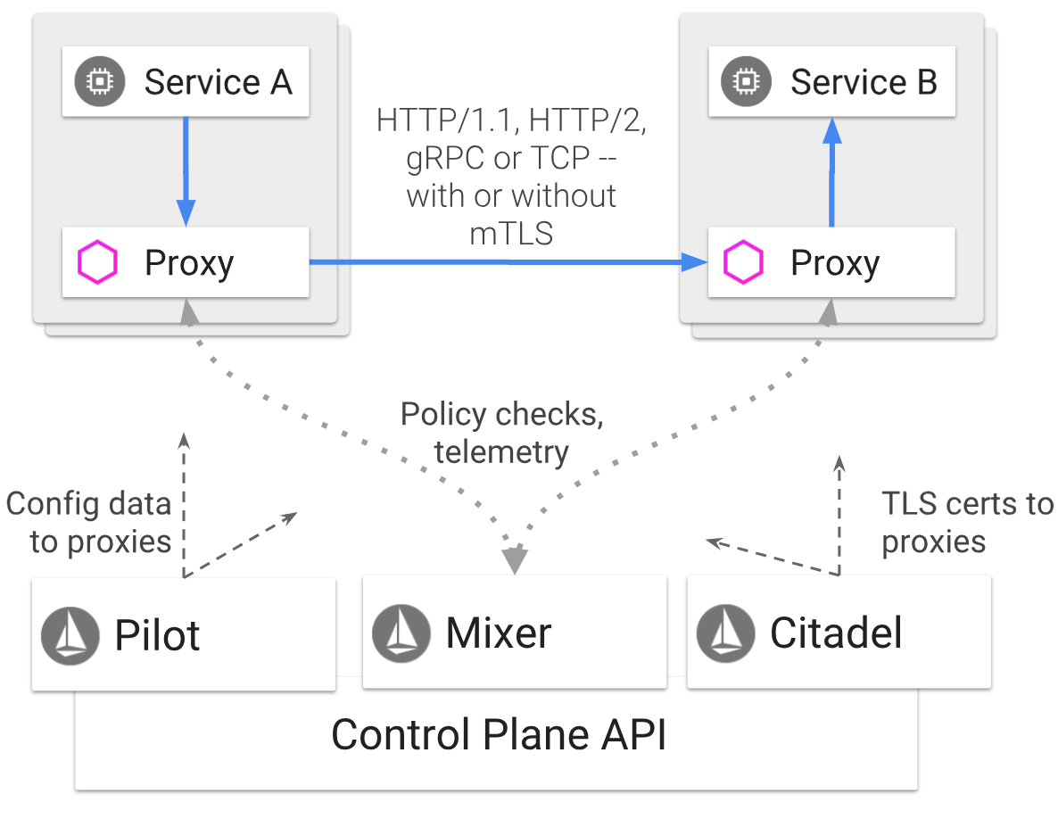
Istio
Architecture Overview
Notes:
Istio is a Service Mesh which can run on Kubernetes
Istio has a Control Plane and Data Plane
Envoy belongs to the Data Plane
Istio uses extended version of Envoy Proxy and leverages many of its features such as
Dynamic Service Discovery
Load Balancing
TLS Termination
Circuit Breakers
Health Checks
Staged rollouts with %-based traffic split
Fault Injection
Metrics
Envoy is deployed as a side car to all pods in the Istio enabled namespace
Pilot, Mixer and Citadel belong to the Control Plane
Mixer
Enforces access control and Usage Polices across the service mesh
Collects telemetry data from Envoy proxy and other services
Pilot
Provides service discovery for Envoy sidecars
Provides capabilities for intelligent routing features like
A/B tests
Canary deployments
Provides Resiliency by enabling
Timeouts
Retrys
Circuit Breakers etc
Citadel Provides
Service to Service and end user authentication with built-in Identity and Credential Management

Slide 13
Istio
Prerequisites
A working Kubernetes cluster
Tiller enabled on the cluster
Helm, git CLI on client
Installation Steps
Git clone Istio locally
Navigate to istio-1.2.5 folder and execute the below command
Helm template installl/kubernetes/helm/istio –name istio –namespace istio-system –set ingress.enabled=true –set grafana.enabled=true –set servicegraph.enabled=true –set tracing.enabled=true –set kiali.enabled=true > $HOME/istio.yaml
Kubectl apply –f $HOME/istio.yamll
Kubectl label namespace <<namespace_name>> istio-injection=enabled
Installation Steps
Notes:
Tiller is the server side component of Helm

Slide 14
Istio
CRDs !!!
Abstraction over k8s

Slide 15
Istio
Virtual Service
Service Abstraction

Slide 16
Istio
HTTP Ingress Gateway
HTTPS Ingress Gateway
Simple Egress
Egress Gateway
Traffic Management
Notes:
HTTP Gateway
Show the Http Gateway related Istio yaml and explain
Talk about VirtualService type CRD, match, route etc
Talk about Gateway, ports…
HTTPS Gateway
Show the Https Gateway related Istio yaml and explain
You create a cert pair
Then create a secret in Kubernetes
Use the secret in the yaml
Simple Egress
Show and talk about the egress-with-virtualservice.yaml
Egress Gateway
If you need an org wide egress control, use the egress gateway
Show and talk about the

Slide 17
Istio
End User Authentication
Security

Slide 18
Istio
Distributed Tracing with Jaeger
Prometheus
Grafana
ServiceGraph
Fluentd
Telemetry
Notes:
Distributed Tracing with Jaeger
kubectl port-forward -n istio-system $(kubectl get pod -n istio-system -l app=jaeger -o jsonpath='{.items[0].metadata.name}') 16686:16686 &
http://localhost:16686/search
Show the header values to be used in your code
Prometheus
You may query all the metrics from here. Custom metrics also show up here
kubectl -n istio-system port-forward $(kubectl -n istio-system get pod -l app=prometheus -o jsonpath='{.items[0].metadata.name}') 9090:9090 &
http://localhost:9090/graph?g0.range_input=1h&g0.expr=istio_double_request_count&g0.tab=1
It can be used to setup alerts based on metrics too
Grafana
Use this to monitor mesh traffic
kubectl -n istio-system port-forward $(kubectl -n istio-system get pod -l app=grafana -o jsonpath='{.items[0].metadata.name}') 3000:3000 &
http://localhost:3000/d/1/istio-mesh-dashboard?refresh=5s&orgId=1
Service graph
Provides real time view of service relationship
kubectl -n istio-system port-forward $(kubectl -n istio-system get pod -l app=servicegraph -o jsonpath='{.items[0].metadata.name}') 8088:8088 &
http://localhost:8088/force/forcegraph.html
Fluentd
You can create custom logs and send it to Fluentd deamon
Fluentd is an open source log collector with pluggable architecture. You can plug it to multiple sinks. I have plugged it to Elastic Search and Kibana here
kubectl -n logging port-forward $(kubectl -n logging get pod -l app=kibana -o jsonpath='{.items[0].metadata.name}') 5601:5601 &
http://localhost:5601/app/kibana#/management/kibana/index?_g=()

Slide 19
Fictitious App
GiftShop App

Slide 20
Build & Run
Tools
.Net Core 2.2 SDK
VSCode
Docker CLI
PKS CLI
HELM Client
Chocolatey if you are using Windows
Git Client
Skills
Git
.Net Core
Docker
Prerequisites

Slide 21
Build & Run
Harbor
UI url: https://harbor.pksone.io
CLI login: docker login https://harbor.pksone.io
PKS Cluster
pks get-kubeconfig training –u <username> -p <password> -a api.pksone.io -k
kubectl config use-context training
kubectl config set-context –current –namespace=<username>-ns
PKS Environment

Slide 22
Build & Run
Code
Git url: https://github.com/sreenivasmrpivot/ProgNet2019K8sIstio.git
Overall application development has be divided into multiple Labs with details instructions in Readme
Workshop Structure

Slide 23

Transforming How The World Builds Software
© Copyright 2017 Pivotal Software, Inc. All rights Reserved.

